Slide 1
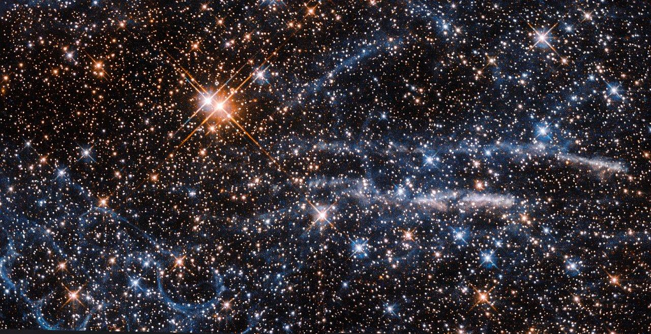
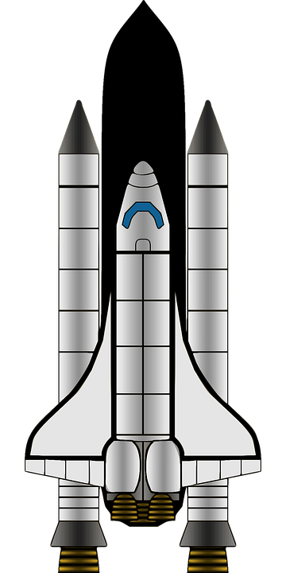
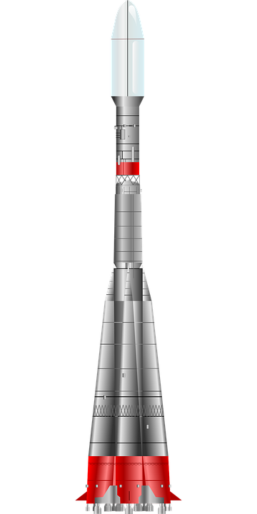
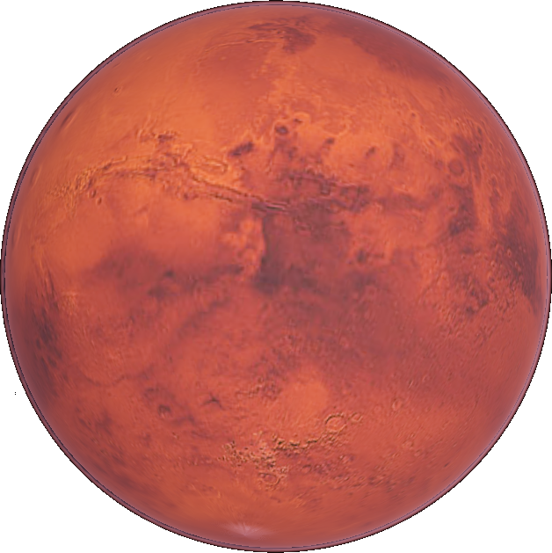
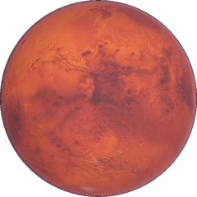
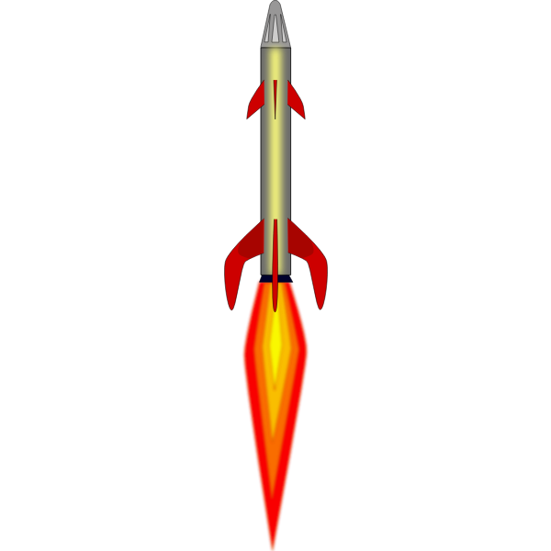
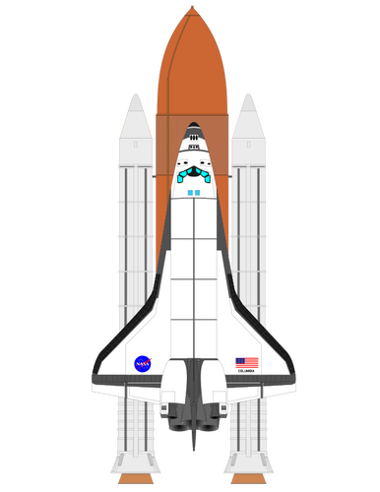
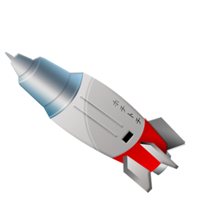
Mars
Mars

Slide 2
Here are some facts about Mars
Mars has a nickname ‘the red planet’ Because of the the iron oxide chemicals in its soil looks like rust.
A year on mars is 687 Earth days
It has 2 moons Phobos and Deimos
Mars is home to the largest mountain
in the Solar System Olympus Mons
The atmosphere of Mars is much thinner than Earth's. It’s atmosphere contains more than 95% carbon dioxide and much less than 1% oxygen.

Slide 3
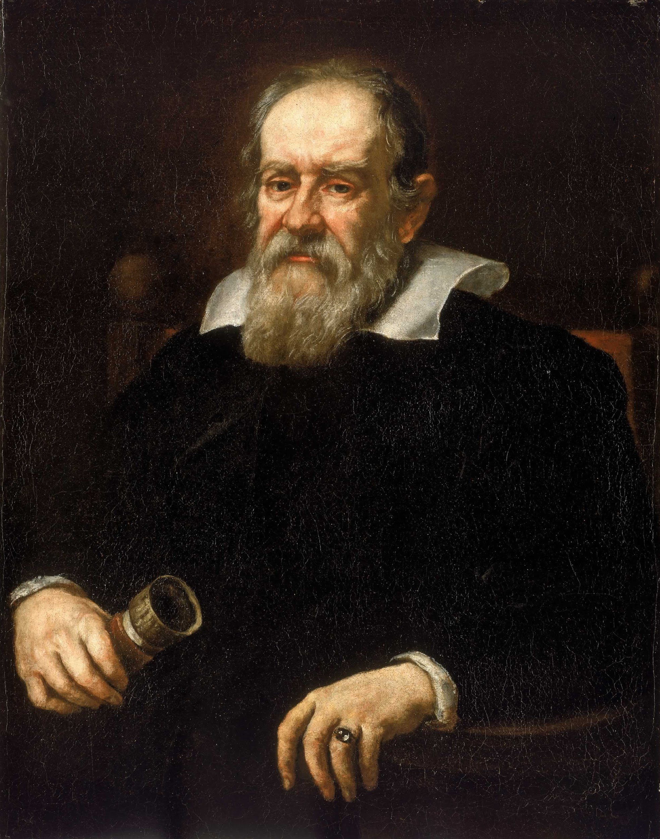
Who Discovered Mars ?
In 1610 Galileo Galilei was known as the first person to use a telescope to make astronomical observations. His records indicate that he began observing Mars through a telescope .

Slide 4
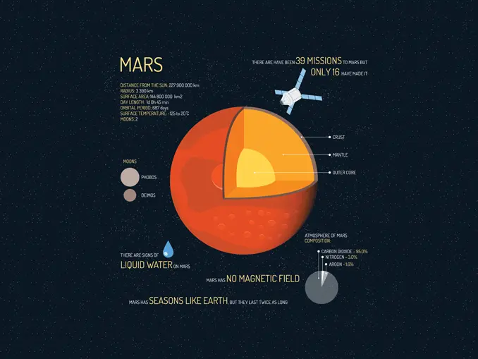
What is Mars made of ?
What is Mars made of ?
It is made up primarily of silicon, oxygen, iron, and magnesium and probably has the consistency of soft rocky paste. It is probably about 770 to 1,170 miles thick, according to NASA.
Mars’ surface is covered in a thick layer of oxidized iron dust and lots of volcanoes and canyons.

Slide 5
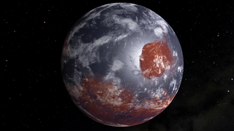
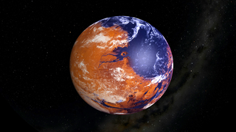
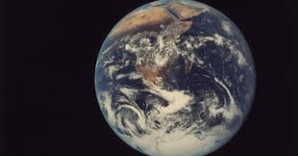
Now here is a question nobody knows the answer to
Was there ever life on Mars?
And if so.. that must mean Mars was once habitable

Slide 6
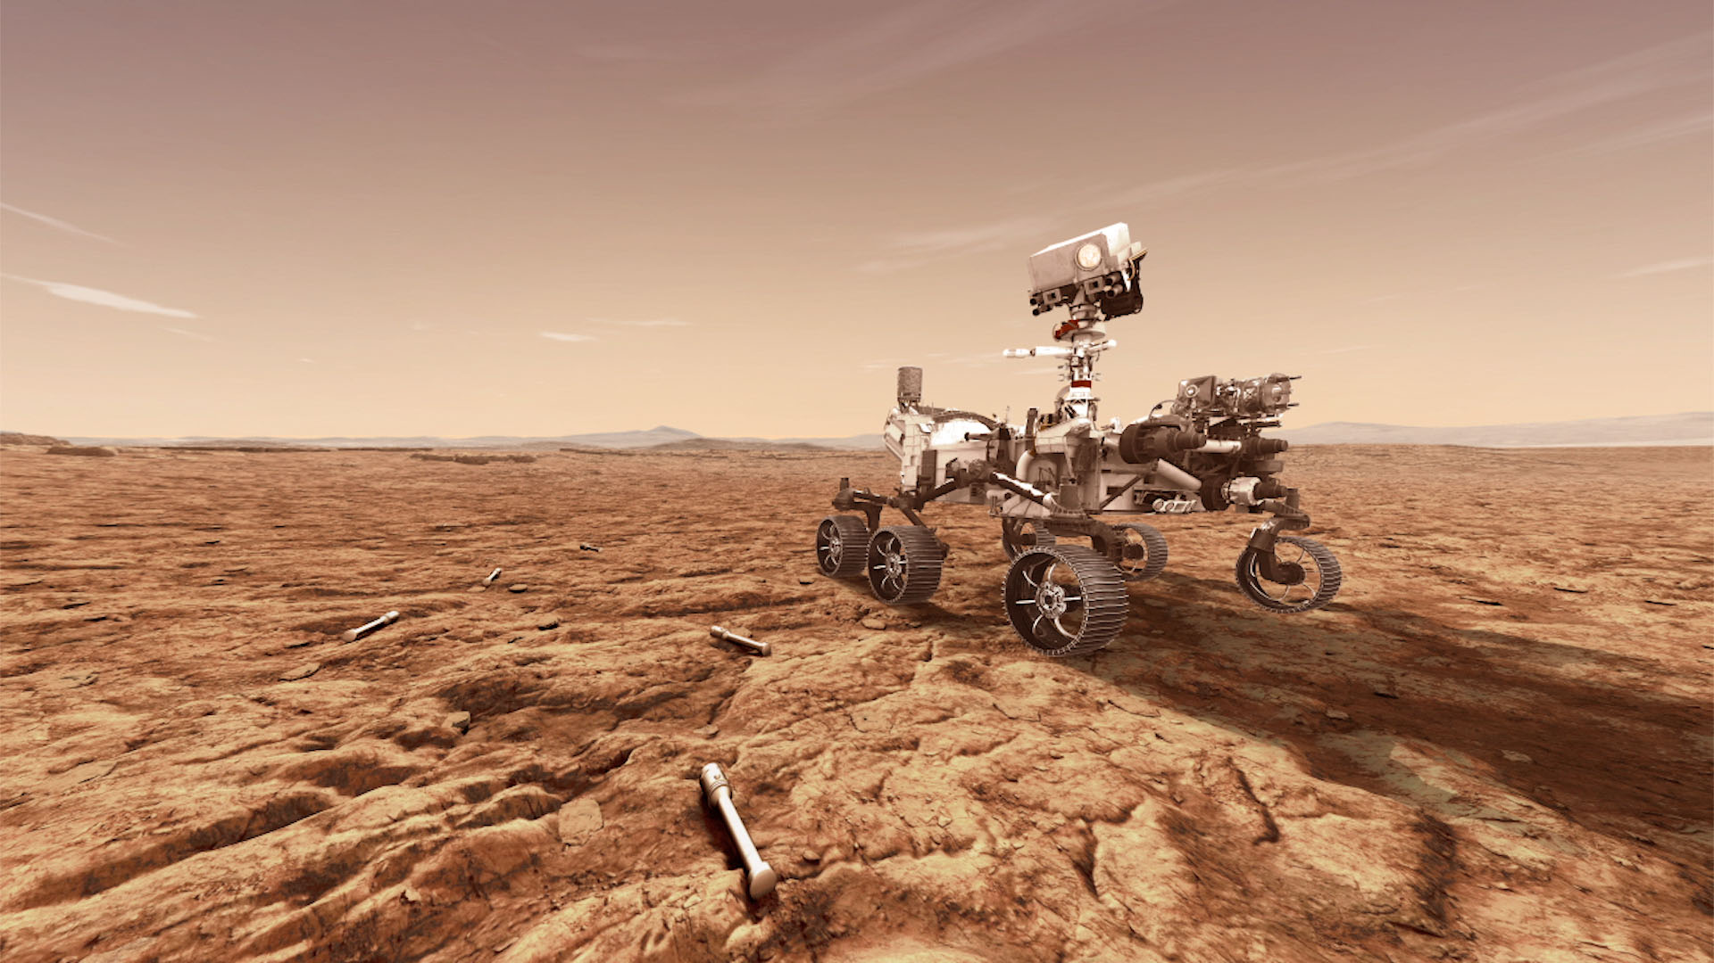
NASA has sent a rover to Mars and it will land on the 18 of Feb
The rover is going to spend 687 Earth days exploring Mars and looking for evidence of ancient life.

Slide 7
Another question is:
Will we ever be able to live on Mars?
Mars is probably the most habitable planet excluding Earth. If we were to live on Mars, we would need an artificial home with a water system as well as an oxygen system. We would obviously need spacesuits, and lots of other countless things.

Slide 8
The end
By Sophia

